Slide 1
Auditing SQL Server
Jonathan Allen

Slide 2
Jonathan Allen
Working with SQL Server since 1999 / SQL 7.0
15+ years as full time DBA
5 years as Premier Field Engineer
Founder of Data South West user group

Slide 3
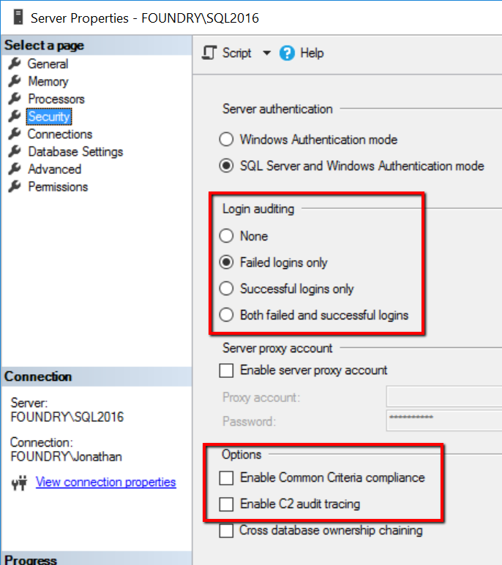
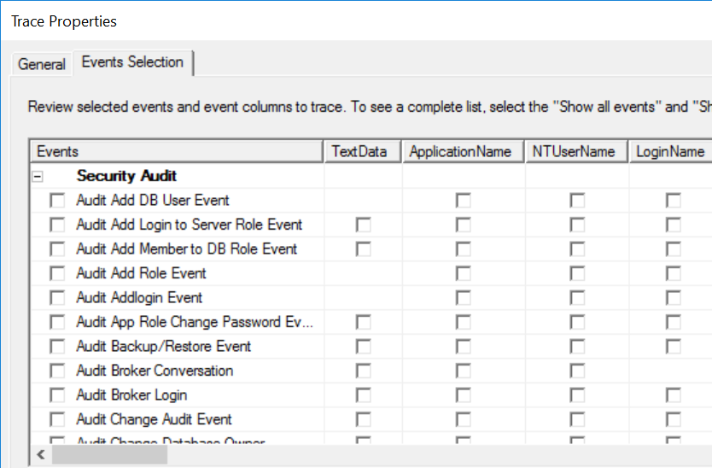
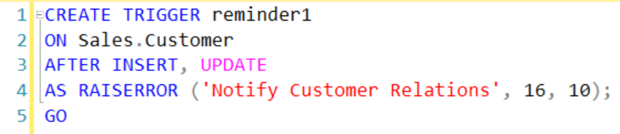
Auditing options
Login auditing
Common Criteria Compliance
C2 Audit
SQL Server Profiler Audit
Server / Database triggers

Slide 4
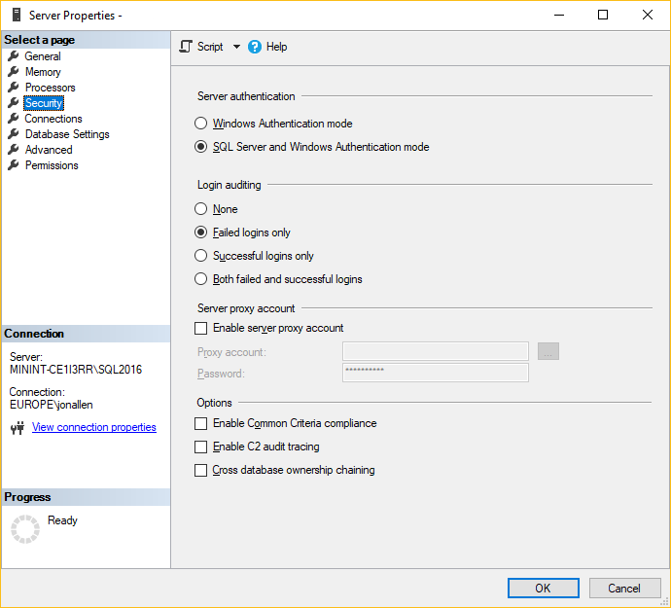
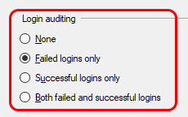
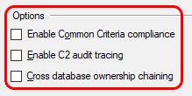
Auditing SQL Server
Default login auditing
Notes:
Login auditing – only success or failure but certainly the most commonly used. Event gets logged in SQL Server log and Application Event Log
CCC / C2 – highly aggressive auditing to meet compliance requirements. High activity systems will show a noticeable load increase when enabled

Slide 5

SQL Server – Server and Database Audits
Server Audit
Audit properties
Name
Size
Roll-over options
etc
Output
Server Audit Specification
Database Audit Specification
System Event Logs
Application or Security
Folder location
Default is SQL Instance LOGS folder.
Notes:
Database Audit Specifications were / are Enterprise only feature on versions prior to SQL 2016

Slide 6
SQL Server Audit – creation workflow
CREATE SERVER AUDIT SPECIFICATION
CREATE SQL SERVER AUDIT
ENABLE AUDIT
ENABLE AUDIT SPECIFICATION
MONITORING OF EVENTS
CREATE DATABASE AUDIT SPECIFICATION
Notes:
1 – Create the Audit with a logical name. Something meaningful and descriptive of its purpose.
2 – Create either a Database or a Server specification.
Choice depends on scope and the items you want to audit
Again name should be
Needs to be associated with the Audit created in 1
3 – Enable the Audit and the Audit Specification
4 – Monitor / review the data. No point collecting it unless you review it
To disable / remove / alter any you need to 'unroll' this process

Slide 7
SQL Server Audit – Drop/Alter workflow
DROP/ALTER SERVER AUDIT SPECIFICATION
DROP/ALTER SQL SERVER AUDIT
DISABLE AUDIT
DISABLE AUDIT SPECIFICATION
MONITORING OF EVENTS
DROP/ALTER DATABASE AUDIT SPECIFICATION
Notes:
To disable / remove / alter any you need to 'unroll' this process

Slide 8
Demo

Slide 9
So why SQL Server Audit?
For
Against
GUI for setup and management
Easy to recreate via TSQL
Very configurable
Great for security
Little/Zero penalty for usage
Can collect a lot of information
Can have a severe effect on your server availability if you choose Stop Service option
Can get complex to be very specific on event filter

Slide 10









Sponsors
Thank you!
We couldn’t do it without you.

Slide 11
References and more information
SQL Server Audit
https://learn.microsoft.com/en-us/sql/relational-databases/security/auditing/sql-server-audit-database-engine
Action Groups and Actions
https://learn.microsoft.com/en-us/sql/relational-databases/security/auditing/sql-server-audit-action-groups-and-actions
Audit Records
https://learn.microsoft.com/en-us/sql/relational-databases/security/auditing/sql-server-audit-records
EU General Data Protection Regulation (GDPR)
https://microsoft.sharepoint.com/sites/Infopedia_G01/Pages/Cards/TrustedCloud-GDPR.aspx
SQL Server and the GDPR
https://microsoft.sharepoint.com/sites/infopedia/pages/layouts/kcdoc.aspx?k=G01KC-1-26721

